Slide 1
Using Frameworks
Dr. Deana Pennington, Associate Professor
Department of Geological Sciences
University of Texas at El Paso
October 19, 2017

Slide 2
Frameworks
A standardized “model” for representing particular kinds of problems
Designed to be used by a wide community of researchers and practitioners
Permit structured, interdisciplinary reasoning about complex problems
A dozen often used frameworks, designed for different purposes

Slide 3
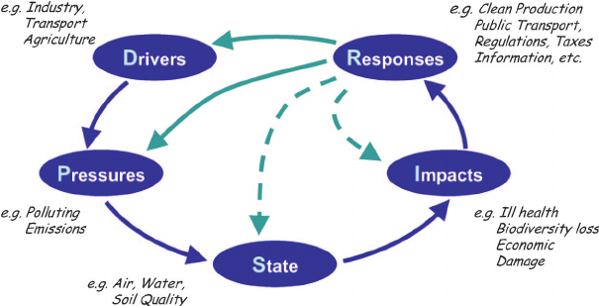
(DPSIR) Drivers-Pressures-States-Impacts-Responses
Policy Choices
European Environmental Agency

Slide 4
DPSIR – Policy Choices
Drivers: Changes in the social, economic and institutional system that directly or indirectly trigger pressures on the environmental state.
Pressures are the anthropogenic factors inducing environmental change.
State: A specific indicator of environmental change. An attribute of the environment that can be measured.
Impacts: Effects on social, economic, and environmental dimensions caused by the change in state.
Response: Policy actions that are triggered by perception of impacts which attempt to prevent, eliminate, or reduce consequences.

Slide 5
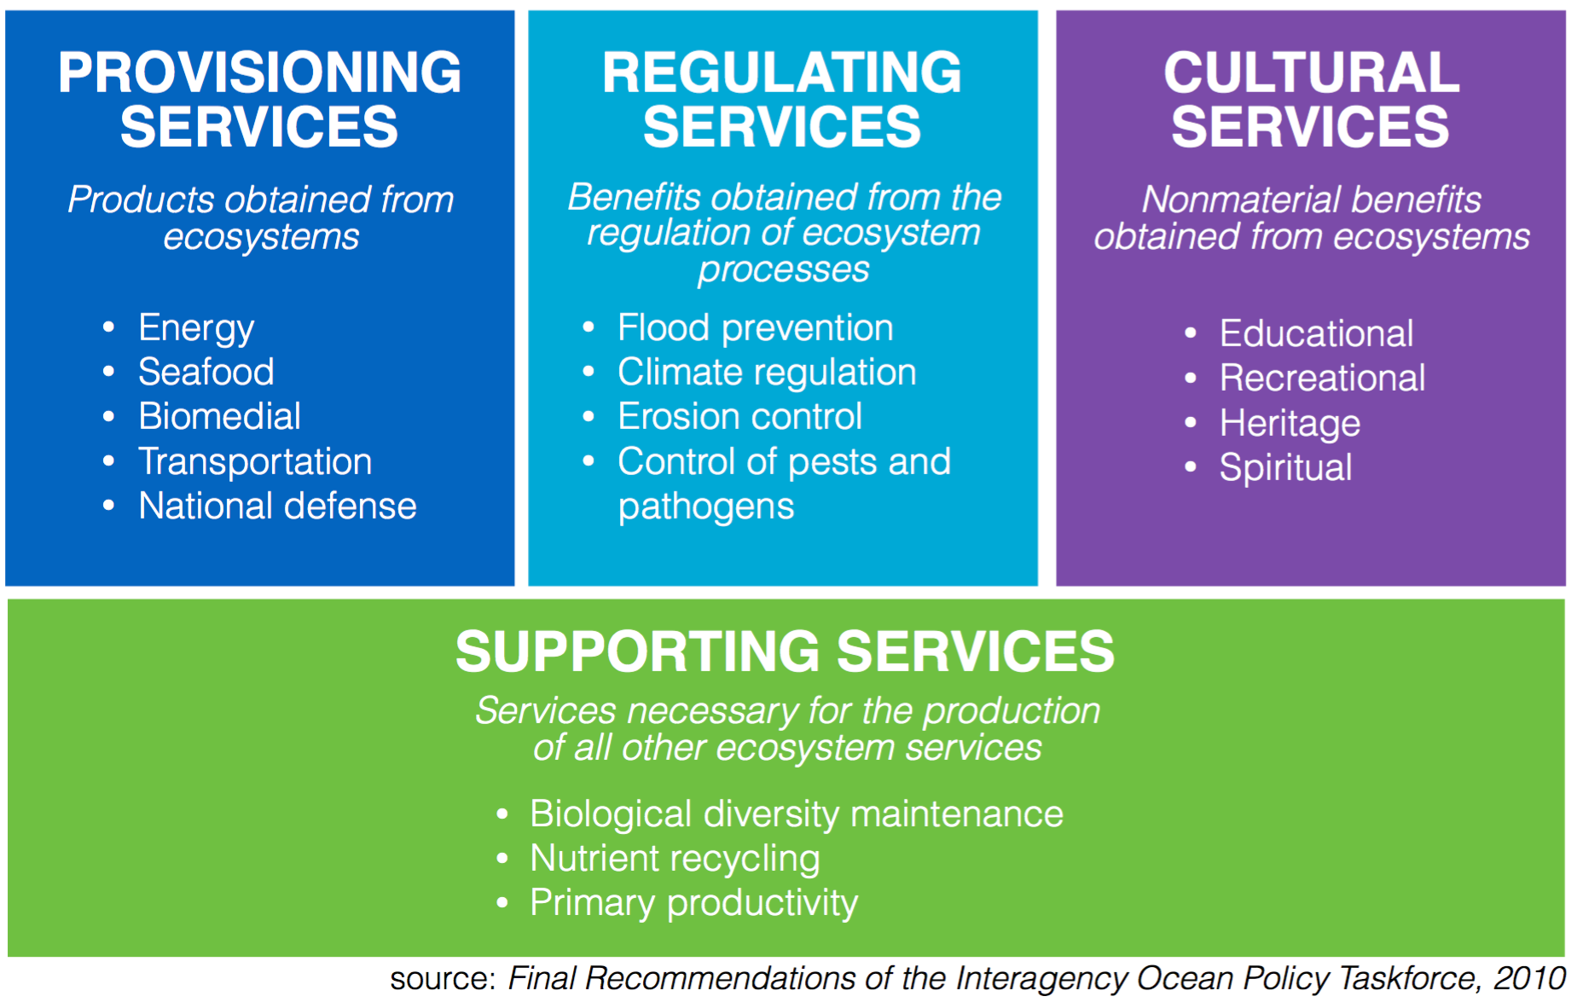
Ecosystem Services - Ecocentric
Benefits gained from the natural environment
Provisioning: food, crops, spices
Regulating: air/water quality, climate
Cultural: Recreation, values
Supporting: Environmental processes that make the other 3 categories possible – primary production, soil formation

Slide 6
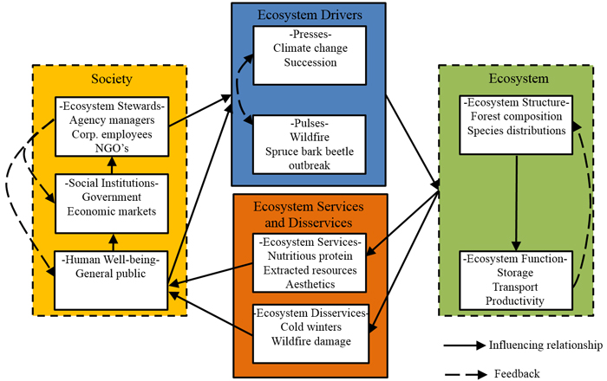
(PPD) Press-Pulse Dynamics Framework – Ecocentric/Integrative
Press: long term change
Pulse: short term change
Long Term Ecological Research Network

Slide 7
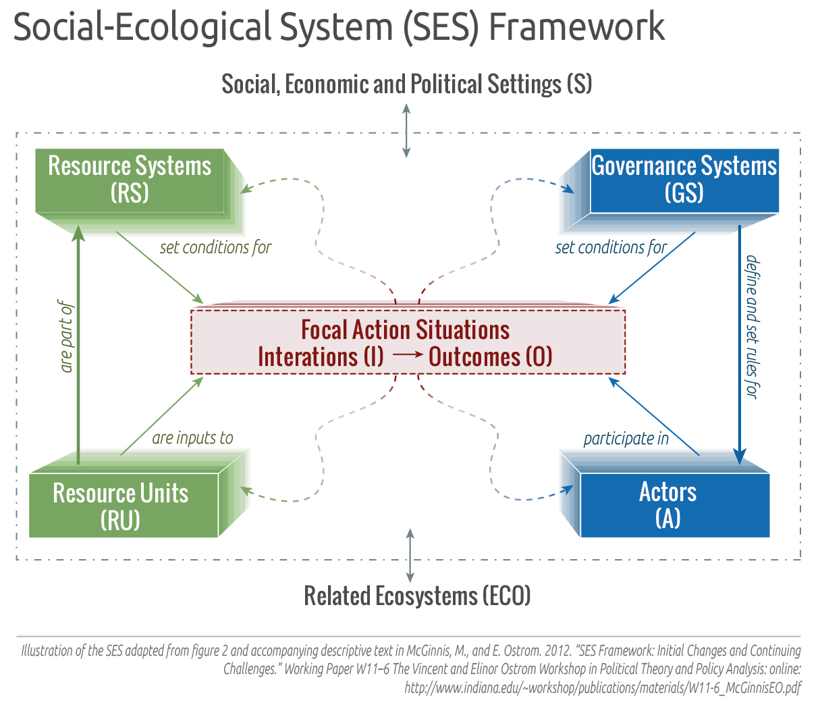
SES Socio-Ecological Systems – Policy/Integrative
Ecological
Social

Slide 8
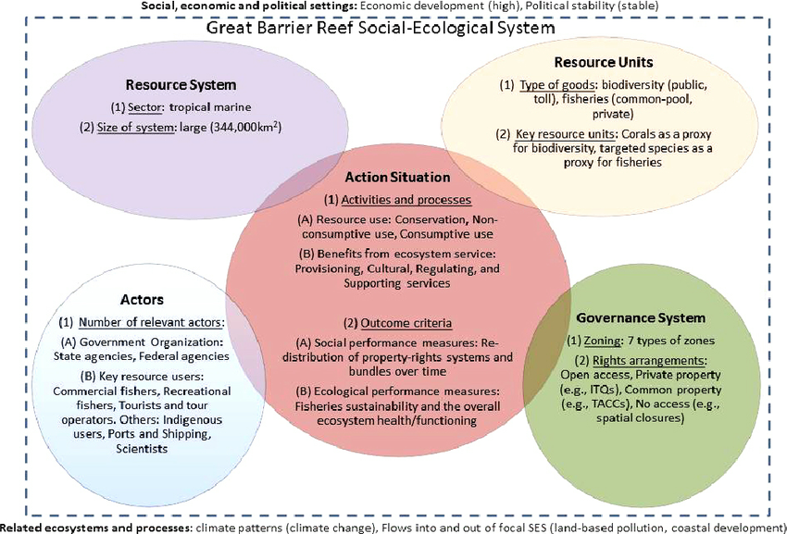
SES Example

Slide 9
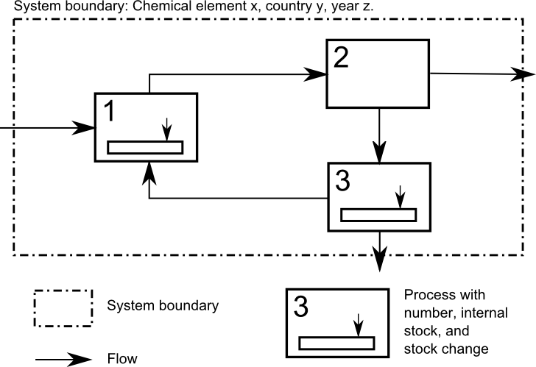
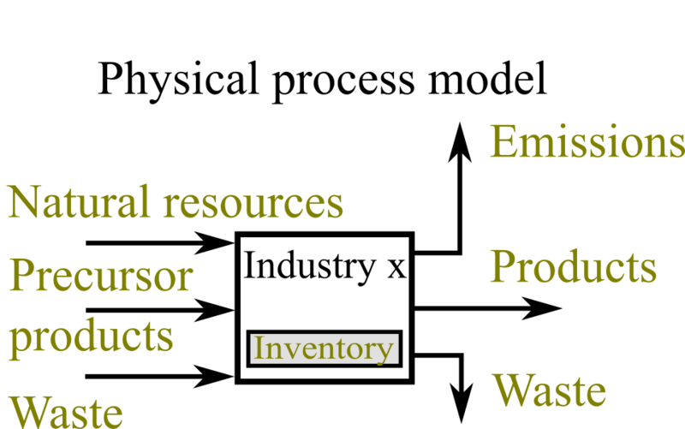
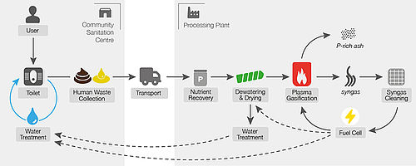
Material/Energy Flow Analysis (MFA) – Ecocentric
By Stefan Pauliuk - Own work, CC BY-SA 3.0, https://commons.wikimedia.org/w/index.php?curid=15695534

Slide 10
Activity: Simplify with Frameworks
FIRST: Choose one of the frameworks
Work individually to map the items from your mind map from last week into the framework
Once you all have organized your thinking, co-create your final framework.

